Slide 1
Idaho Healthcare Conference
Lindsey Shelton
Provider Networks
lshelton@mhc.coop
mountainhealth.coop
800-299-6080
Notes:
Hello everyone! I know many were disappointed in today being a virtual conference, but I still plan on covering a lot of good material and am open to any questions you may have. Please save all questions until the end and then don’t forget we also have a virtual booth experience at the end of the conference if you didn’t get what you needed after my presentation. That time is meant to serve as time you would come chat with me at an in-person booth.
Some house cleaning items, I am working remotely today and where I am at, there are some nasty thunderstorms so please hang tight if I lose connection. I do have Kelsey Walker from our MT office on with me to step in if need be. She will not be able to answer any ID specific questions, but she can take them down or schedule a time for you to meet with me. I hope, that if that happens, I can just transition to my cell phone and just have Kelsey share my slide deck.
To jump in, right now, MHC is in the mist of recovering from our TPA switchover 9/1. I will say we did think we were prepared but, in all honesty, we got turned upside down. Every day is getting better, and I thank you to each and every one of you that has stuck with us through the ups and downs with this transition.

Slide 2
Mission
We offer non-profit member-governed health insurance that promotes member engagement and provides access to high quality medical care.
Vision
Champion a more innovative, member-centric healthcare delivery system by promoting the triple aim where providers are engaged to improve population health, improve individual healthcare, and control healthcare spending.
Core Values
Customer focus
Communication
Quality
Integrity
Responsibility
Respect
Credibility
Innovation
Teamwork
Notes:
I want to start by refreshing everyone on our mission, especially if you are newer to working with the CO-OP. Our vision and core values have not changed, and we are still wanting to provide the best service. That is why we are striving each day to get back to the level of service you all know us for.

Slide 3
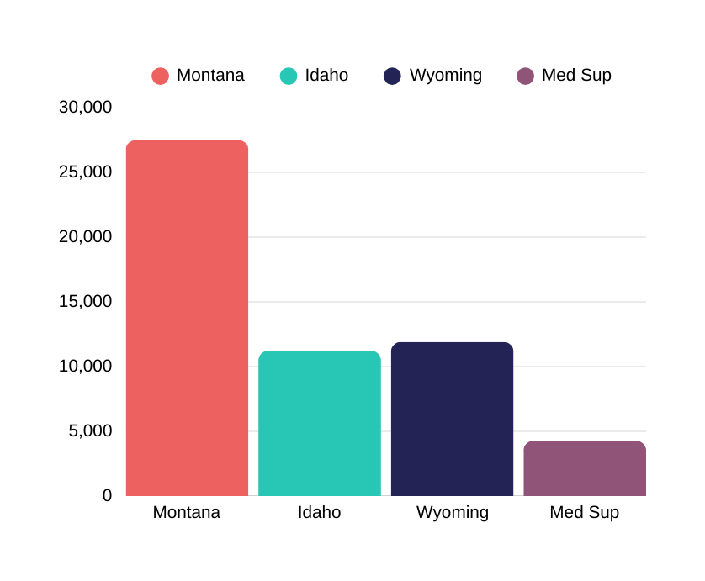
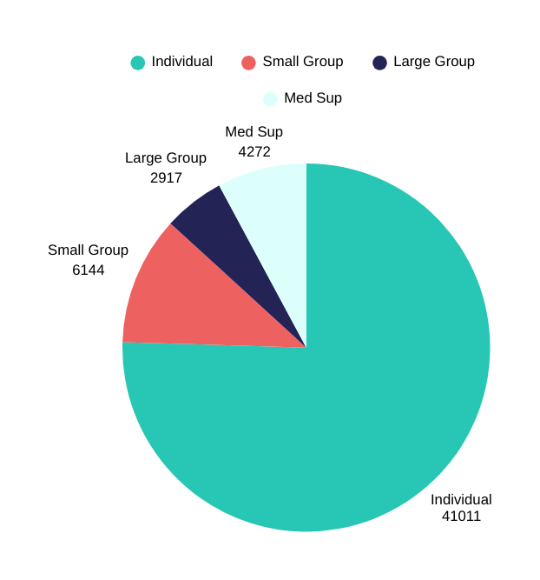
Membership Snapshot
March 2025 (Total by State)
March 2025 (Line of Business)
TOTAL MAR. 2025 54,762
Where were we last year?
MT: 27,488
ID: 11,215
WY: 11,899
Med Sup: 3,105
TOTAL MARCH 2024 53,707
Notes:
We are staying strong every year with our ID membership despite all the competition here in Idaho. We are currently at right above 10,000 members with last year being at 11,215. Our total member population in all 3 states is currently at 54,762 with last year being 53,707.

Slide 4
Customer Service
Calls are being answered in less than a minute.
800-299-6080
Provider calls
March 2025:
Average number of provider calls per week: 1120
Average Speed of Answer : 78.5% within 30 sec – Goal is 80%
Average Handle Time 7:34m
Notes:
I want to make sure everyone is aware that with our TPA transition we did get a new customer service telephone number. For right now, the old number has been mapped to this new one so you will still get through. But at some point, our old number will be turned off. We do have better call metrics that are being reported to the CO-OP and that has been something we were very serious about improving.
We strive for answering 80% of calls within 30 seconds and right now we are measuring right at 78.5% with most calls lasting around 7 and a half minutes. We are still having a large call volume daily and last week we were at 1120 provider calls for the week. That averages to around 224 calls a day.
I know this customer service line we have struggled with, and things are getting better but like I said we are very serious around improving this experience for you all.

Slide 5
Our Partners
Medicare Supplements
The CO-OP offers Medigap Plans A, F, G & N across Montana, Idaho and Wyoming.
UFLIC
800-366-8354
Please submit claims to:
Mountain Health CO-OP
PO Box 2209
Duncan, OK 73534
New!
High Deductible Plan G available May 2024!
Notes:
We offer our members Medicare Supplements plans in all 3 states with a new high-deductible plan G as of 2024.
However, I want to point out that the Third-Party Administrator is still not MHC but rather UFLIC. Those claims should automatically pass over to us through Medicare but in case they do not you can always submit claims to the address shown here in Duncan OK.
The ID cards will look different than MHC ID cards as well as the member ID numbers look different as well.
Claims will cross over from Medicare to UFLIC and you should only have to mail to the PO box in rare cases that that cross over does not happen.

Slide 6
Provider Claim Payments
Our provider pay cycle is weekly on Mondays with payments received around Thursday.
Electronic Funds Payments & Electronic Remittance Advances
EFT enrollment form can be found on our website, mountainhealth.coop
Enroll in ERAs with your clearinghouse
Our clearinghouse is Optum Change Healthcare
Address Issues:
Please contact us if you have not received mail at the right address
Notes:
Provider Pay cycle is set up for weekly on Mondays. If you don’t already have EFT set up, please email me for that form. For ERA you will contact your clearinghouse and have them work with Optum. We have encountered some issues with pay to addresses. Please contact me if your remits/claims weren’t sent to the right address.

Slide 7
Provider Portal
If you have not already enrolled in our provider portal, please email providerportal@mhc.coop for your registration code. We will need your Tax ID & zip code.
What will you find on our provider portal
2025 Member Eligibility
Benefits (look under “Plan”)
Id Card
Claims (including pending claims)
Portal Engagement
Engagement:
+17k reg members (8k logged in last month)
+5.5k reg providers (3k logged in last month)
Top 3 visited pages:
Member (claims, message center, my account)
Provider (member lookup, claims, payee info)
Notes:
Here is the email for if you need help getting registered for our provider portal. Please note that this email box is for portal registration and portal support only and all claims' questions need to be directed to provider@mhc.coop.
2024 member eligibility is currently unavailable and will not be fixed until 2025 but a solution has been found for 2025. Due to this, if a member terminated coverage in 2024, you will not be able to find the member in our portal. In situations like these you will want to reach out to our customer service team.
Dependent ID numbers are also not available in the portal currently. Please either reach out to me or our customer service if you do not have a copy of the member’s ID card and need the dependent number.

Slide 8
Prior Authorizations
MHC Providers – directly contracted with MHC
Personify
Healthcomp
Medcom
myCarehc.com
833-412-4144 P
559-243-7012 F
PA list @ mountainhealth.coop – this is also available on our website under the provider tab and prior authorizations
Notes:
ID providers will ALWAYS PA with Personify. I know there has been some confusion around American Healthcare Holdings. That is for Aetna providers in our wrap network only and will not pertain to you. Therefore, you will use the information on the listed here on the screen

Slide 9
Prior Authorizations
There is a known issue that caused claims processed in December & January to denied for no prior authorization.
Those claims have been identified and reprocessed.
Notes:
If you are still having issues around this timeframe with claims not processing correctly, please contact me directly.

Slide 10
MHC Providers
How to submit Appeals
Clinical Denials & Claims Processing
Zelis Claim or Line Denials
Appeals form on our website
Include Medical Records
Fax 800-781-6260
PO Box 30311
SLC UT 54130
For Appeal status, call 833-412-4144, Option 2, 2
Zelis appeals form on our website
Include medical records, itemization, & copy of claim
Fax 908-658-3511
Billreview.integrity@zelis.com
Notes:
There are 2 appeals processes. There is a process for you appeal clinical denials and claim processing denials and that is to go use our appeal form listed on our website and to make sure you include medical records as documentation. The other is if you get a Zelis claim denial or Zelis line denial. In those cases, you will want to appeal directly to them using the information on the screen.
If you are new to MHC or need a refresher from previous years presentations, Zelis is our high dollar claim reviewer as well as our auditor for correct coding.

Slide 11
Contracted with MHC Directly
BrightPath/SLHP
Providers
Need to add a new provider
Mountainhealth.coop
Providers
Add New Provider Form
Please reach out to BrightPath directly.
208-381-1564 option 1 for existing providers
SLHealthPartners@slhs.org
Notes:
If you are contracted with MHC using BrightPath/SLHP then you will need to add a provider or update any contract information, please reach out to them directly.
If you are directly contracted with MHC and need to add a provider, then we have a form on our website that you fill out electronically and it immediately gets sent to our credentialing team. Also on our website we have a provider update form if you are needing to update any addresses etc.

Slide 12
Thank you!
800-299-6080
mountainhealth.coop
Notes:
I know the CO-OP has had many changes in the last 6 months and I am here to support you while we continue to gain our footing. What questions do you have for me?

