Slide 1
Contracting and Credentialing: Tips and Tricks
Lisa Battrick & Nichole Kelly, Provider Relations Executives
May 6th & May 8th, 2025

Slide 2
Presenters
Lisa Battrick, Leesa Gilbertson, and Nichole Kelly

Slide 3

Ice Breaker

Slide 4
Disclaimer
The slides in today's webinar are for educational purposes only
The information is not inclusive of all our contracting and credentialing requirements
Please continue to use the resources on regence.com and Availity Essentials for the most up to date information

Slide 5
Agenda
The contracting and credentialing process
Credentialing simplification
Availity Essentials
Electronic funds transfer
Paperwork and agreements
Bringing it all together
Additional resources
Questions

Slide 6
The contracting and credentialing process
Steps to keep you on track

Slide 7
Contracting and credentialing
Important points
EXISTING GROUPS
GROUPS THAT ARE NEW TO REGENCE
Submit a credentialing application for your provider
Track the application status using the onboarding tracker tool in Availity Essentials
  NOTE: the EFT (Electronic Funds Transfer) status will remain in RED
The tax ID owner will be notified when the application is complete and will be provided with the network participation effective date of the provider
Submit a credentialing application for your provider
Register for Availity Essentials
Enroll in EFT
Be sure Regence has your tax documents
Sign and return agreement documents
  NOTE: Agreements will not be issued until successful credentialing and all required onboarding tasks have been completed

Slide 8
Guide to contracting
Apply for credentialing
Before submitting an application, please confirm:
  We contract with the provider’s specialty type
  Our networks are open
  The provider meets our credentialing criteria
  You have signed CP 175 or 147C letters (if applicable)
  That all new clinics are not already credentialed by contacting the Provider Contact Center

Slide 9
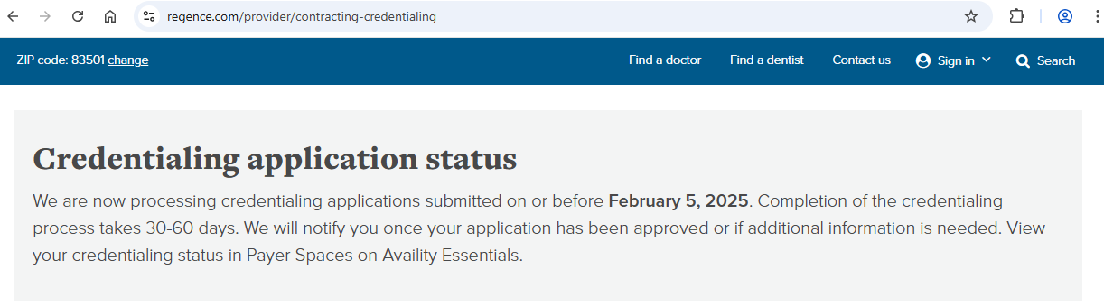
Guide to contracting
Timelines
Credentialing can take 30 to 60 days to complete.

Slide 10
Guide to contracting
Register for the Availity Essentials
While your application is in process, sign up for Availity Essentials.
This portal houses several tools you will use as a contracted provider with Regence.
You can register here: Register
If you need help, please call Availity technical support line at 1(800) 282-4548.
Availity Essentials has several tutorials to become familiar with their tools; find these at the Help & Training link in the Availity Essentials portal menu.
During this time, you’ll most likely only use the onboarding tracker tool.

Slide 11
Guide to contracting
Enroll for EFT and submit your CP 575 or 147C letter
All providers are required to receive payment for claims submitted to us via electronic funds transfer (EFT).
If you did not send in your CP 575 or 147C letter with your application, please fax it to 888-335-3002.
  Groups who have existing contracts with Regence will not have to complete this step
NOTE: If both steps with Availity and EFT are not completed for providers joining new groups, the providers credentialing application will be closed out.

Slide 12
Guide to contracting
Review and sign your agreement
This is the last step and a critical one that often gets overlooked.
Within 30 days of the provider’s credentialing approval, the authorized party will be notified via email that documents are ready for review and signature via DocuSign.
Please have that party add @DocuSign.net to their address book to avoid filtering by anti-spam software
Documents must be signed by an authorized officer; documents cannot be signed with the clinic name
  NOTE: If you are joining a group with a contracted tax ID number, you will not have to sign agreement documents.

Slide 13
Credentialing simplification
To credential or not to credential, that is the question

Slide 14
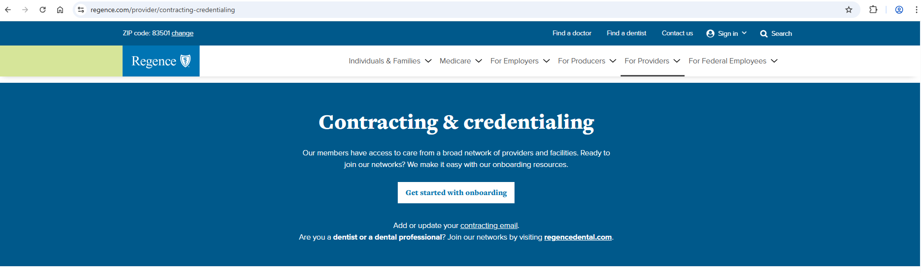
Credentialing doesn’t have to be complicated
Find help on regence.com

Slide 15
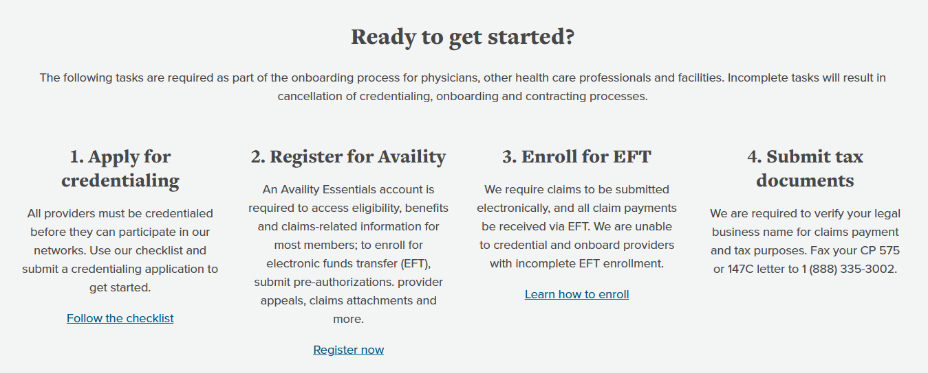
Credentialing doesn’t have to be complicated
Find help on regence.com

Slide 16
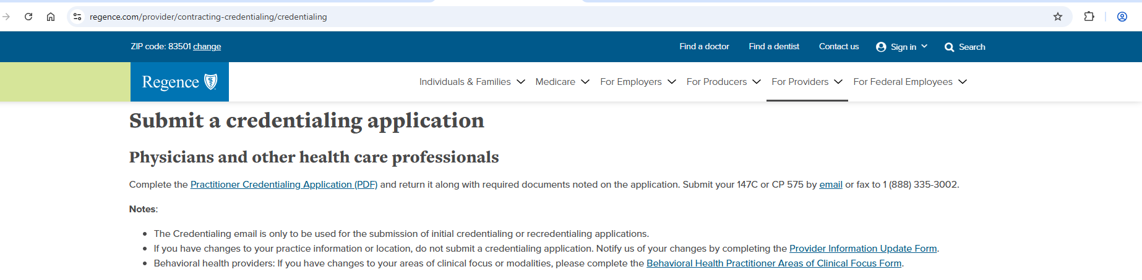
Initial credentialing
If you are coming in new, this information is for you
Physicians and other health care professionals will complete the Practitioner Credentialing Application (PDF) and return it along with required documents noted on the application. Submit your 147C or CP 575 by email or fax to 1(888) 335-3002.
The Credentialing email is only to be used for the submission of initial credentialing or recredentialing applications.
This can be found on our provider website.

Slide 17
Initial credentialing
What if my provider works exclusively at a hospital?
If a practitioner practices exclusively within a hospital, inpatient or free-standing facility setting, complete the Hospital and Free-Standing Facility Based Practitioner Information Form (PDF) and fax to 1(888) 289-1313.
These providers are not credentialed
If the provider moves to an outpatient setting or clinic, submit a credentialing application ASAP.
NOTE: A provider who is not credentialed and provides services in an outpatient setting will not be eligible for reimbursement

Slide 18
Initial credentialing
Example of a notification email
MM/DD/YYYY
This email was auto generated. Please do not respond.
New provider added to your Professional Services Agreement
Dear <CONTRACT OWNER NAME>:
Our Credentialing Committee recently reviewed and approved credentialing documents for <PROVIDER NAME>. This provider has bee notified that credentialing has been successfully completed and that they will be added to your Professional Services Agreement (PSA) for <CONTRACT OWNER NAME>. Refer to your Provider Network Addendum for a list of networks this provider participates in.
<PROVIDER NAME> can submit claims as an in-network provider under your PSA effective MM/DD/YYYY.
We appreciate your continued participation in our networks and the care you provide to our members. If you have questions or would like additional information, please call the Provider Contact Center at 1 (800) 253 0838.
Sincerely,
Network Management
Regence
Please do not reply to this email. This account is not monitored.

Slide 19
Initial credentialing
How can I check the status of an application?
The Onboarding Tracker tool, on Availity Essentials gives you at-a-glance status of your onboarding progress.
• Other helpful reports are available on Availity Essentials:
  • Payer Spaces>Regence>Applications>Provider Reports -for your organization>Credentialing & Maintenance Reports:
  • Credentialing Status Report - credentialing and recredentialing status information for providers in your organization
  • Returned Centers for Medicare & Medicaid Services (CMS) Validation Roster - a copy of the CMS Provider Validation spreadsheet that you sent back to us
  • Provider Roster - a copy of the Centers for Medicare & Medicaid Services (CMS) Provider Validation spreadsheet that we send to you

Slide 20

Initial credentialing
What can delay the credentialing process?
Incomplete practitioner information
Incomplete practice location information
Incomplete education
  Left entirely blank
  All levels of education/training are not listed
  Course of study missing
  Dates either missing or not in a mm/yyyy format
Incomplete hospital affiliations or coverage arrangements
Incomplete work history
  Last 5 years incomplete
  Missing explanations for gaps greater than 6 months
  Dates are not in a mm/yyyy format

Slide 21
Initial credentialing
What can delay the credentialing process?
Incomplete attestation questions form
  All boxes not answered or lines down the form
  No details provided for yes answers
  Not signed or dated –authentic/verified signatures
Incomplete release of information
  Not signed or dated –authentic/verified signatures
Missing malpractice certificate
  Incomplete (professional liability not general liability, coverage limits)
  Group coverage certificate should either include the providers name or a roster of those covered under the policy
Missing DEA certificate
Missing collaborative agreements (applies only to Physician Assistant-Certified)
Missing Curriculum Vitae (CV)

Slide 22
Recredentialing
Don’t let your time off lapse
All providers must be recredentialed every 36 months
  A recredentialing request is sent 3 to 6 months prior to the recredentialing due date
  If a provider’s contract status has lapsed more than 30 days, an initial credentialing application must be submitted.
NOTE: Not having an active practice location is considered a lapse.
Credentialed providers must remain in compliance with credentialing criteria at all times.
Behavior health providers:
  If there are changes to areas of clinical focus or modalities, please complete the Behavioral Health Practitioner Areas of Clinical Focus Form

Slide 23
Recredentialing
Don’t let your time off lapse
What can be done to make this process run smoother?
  Don’t ignore the recredentialing email from Regence
  Don’t let your credentialing lapse
  Promptly respond to requests to verify EFT information
What if I’m part of a delegated credentialing group?
  Contact the person who manages your group’s credentialing

Slide 24
Facility credentialing
Facilities have a separate process and different forms
New facilities need to complete an Organizational Provider/Facility Credentialing/Recredentialing Application (PDF) and return it along with required documents noted on the application.
Submit your 147C or CP 575 letter by fax or email.
Organizational providers that have changed ownership and are required to complete the site survey process by the state and Medicare must be initially credentialed under the new ownership.
Once credentialing is completed the facility will receive notification and a contracting executive will connect directly to execute the contracting steps.
If a facility needs to add or change a location:
  Complete the Organizational Provider/Facility Credentialing/Recredentialing Application (PDF) located on the Credentialing page of our provider website.

Slide 25

Behavior health facilities
If you are a facility , please review our Behavioral Health Medical Policies.

Slide 26
Telehealth providers
Who can Regence credential?
If a provider is:
  Licensed in the Regence service area, and
  Resides AND conducts telehealth services within our service area (home or clinic location),
  OR
  Resides outside our service area but physically conducts telehealth services from a location within our service area (e.g., clinic setting).
  They are eligible to be credentialed and contracted as a network provider.
Out-of-area telehealth providers are not eligible for contracting/credentialing.
If a provider resides and provides telehealth services at a location outside of our service area, we are unable to contract with them.

Slide 27
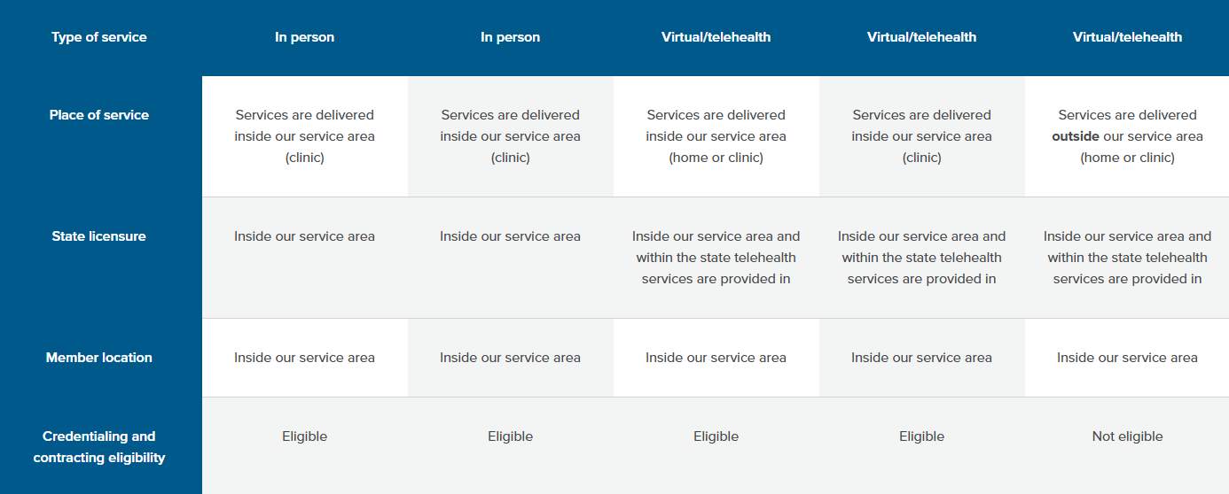
Telehealth providers
Who can Regence credential?

Slide 28
Availity Essentials
Valuable resource with several functions

Slide 29
Enroll with Availity Essentials
Use the onboarding tracker tool
Availity Essentials is a secure multi-payer web portal
Access to several payers with a single sign on (SSO)
Receive an at-a-glance status for completion of required onboarding tasks and obtain the effective date
Find the onboarding tracker under Payer Spaces

Slide 30

Find your fee schedules
Submit claims, appeals and preauthorization requests
Check member eligibility and benefits
Access electronic remittance advice (ERAs)

Slide 31
Enroll with Availity Essentials
Why does the EFT status button remain in red for this provider? We already have EFT.
Groups that have an existing EFT connection with Regence who bring new providers onboard or who have new providers going through credentialing will always see EFT enrollment in red.

Slide 32
Electronic Funds Transfer
We want to pay you and you want to get paid

Slide 33
Electronic Funds Transfer (EFT)
All providers are required to receive payment via EFT
Only exception is providers residing outside our service area
To enroll, use the Transaction Enrollment Tool on Availity Essentials
This is a two step process
After step 1, monitor the status of your enrollments on your Enrollment Status Dashboard.
  NOTE: For security purposes, you will receive a phone call from our EFT enrollment team to validate the information, you provide.
To begin step 2, at the Submit Enrollment step there is a Reason for Submission section. Select Change Enrollment and complete the enrollment process.

Slide 34
Electronic Funds Transfer (EFT)
All providers are required to receive payment via EFT
Step 2:
Select provider
Select health plan
Select transaction
Add identifiers
Add financial information
Submit enrollment
Learn how to enroll for EFT

Slide 35
Paperwork and agreements
Important steps to keep the process moving

Slide 36

We all love paperwork, right??
We MUST have a CP 575 or 147C letter
Did you send it in with the credentialing application?
If yes, great job.
If no, stop everything and fax it to
888-335-3002

Slide 37
Submit your paperwork
What are these forms anyway?
A CP 575 letter is generated by the IRS when an Employer Identification Number (EID) is granted.
Replacement CP 575 letters cannot be generated; a 147C letter contains the same information as the original CP 575.
Request a 147C letter by phoning the IRS at 1(800)829-4933. You can elect to receive the 147C via fax or email.

Slide 38
Review and sign your agreement
Also known as your contract
Delays in signing your contract documents may impact your network participation effective date.
You may also have to complete the credentialing process again!
If you are joining an existing agreement for a contracted tax ID, you will be added to that agreement and will not have to sign agreement documents. The tax ID owner will be notified of your participation date.
The email will contain a link to review your agreement documents in DocuSign. Follow the on-screen instructions to review each page and electronically sign your agreement.
Within 10 business days of signing your agreement(s) you will receive an email that confirms your participation on our network(s) and includes your effective date of participation.

Slide 39
Review and sign your agreement
Sample agreement letter

Slide 40
Bringing it all together
Next steps and common questions

Slide 41

Now that you’re contracted with Regence…
Document your network participation date
Subscribe to our communications
Become familiar with our electronic tools

Slide 42
Common questions
How do I find the participation effective date?
Who initially gets this?
  Providers joining an existing group (already has a contracted tax ID), will be added to that agreement and will not have to sign agreement documents.
  NOTE: The tax ID owner will receive an email to notify them of the provider’s participation date.
  New groups to Regence will receive an email which will contain a link to review agreement documents in DocuSign. Follow the on-screen instructions to review each page and electronically sign the agreement.
      Within 10 business days of the agreement being signed, the authorized signer will receive an email that confirms the provider’s participation on our network(s) and includes the effective date of participation.
    NOTE: You can also find the effective date on the onboarding tracker tool.

Slide 43
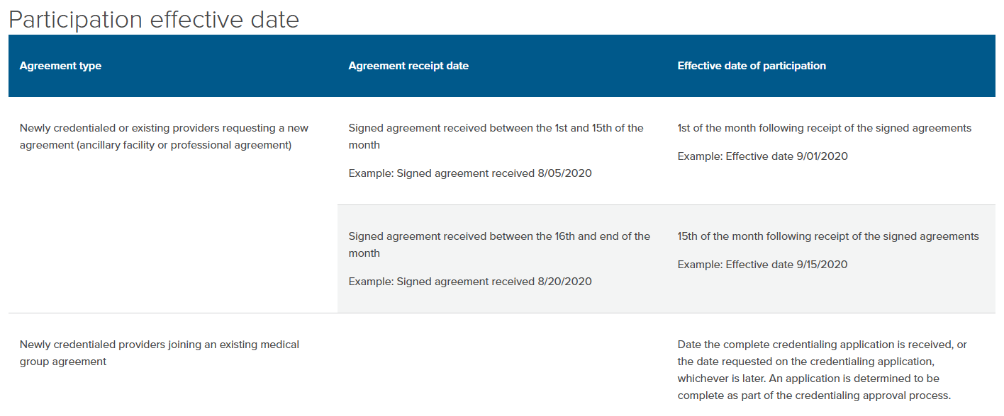
The participation effective date
How do I determine this?

Slide 44
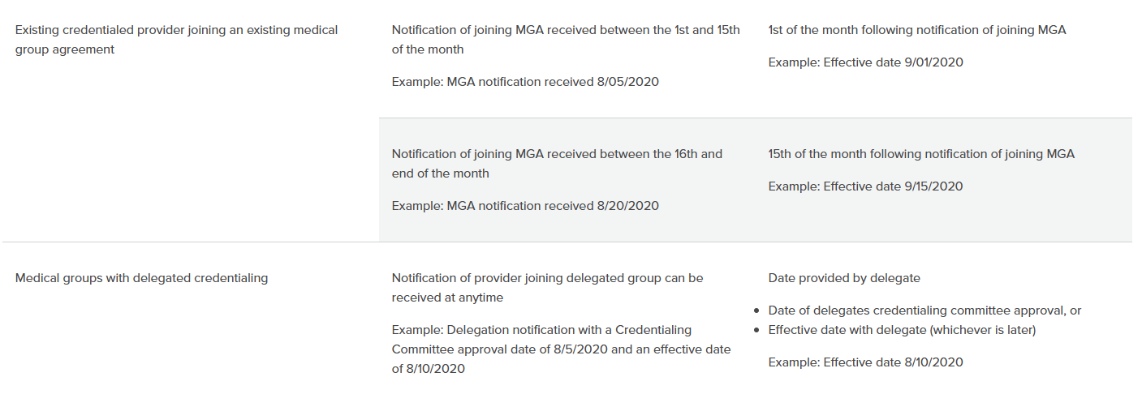
The participation effective date
How do I determine this?

Slide 45
Common questions
How to check demographic information
Use the Find a Doctor tool on regence.com
Choose a network to search by; make sure your location is correct

Slide 46
Common questions
What if the demographic information needs to be updated?
What if my provider’s demographic information has changed?
What if we hired a provider who is already credentialed with Regence?
Submit changes using the Provider Information Update Form

Slide 47
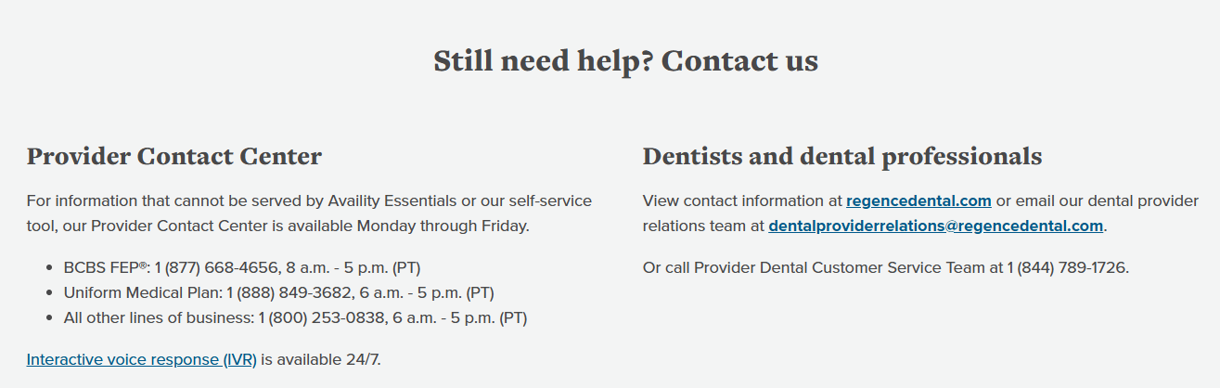
Common questions
What if I have questions about my contract/credentialing?
Please call the provider contact center
  Most questions can be addressed with that call
  If the rep cannot address the question, they will be instructed to have the question researched and will follow up with you.

Slide 48
Regence.com versus Availity Essentials
Where can you find what you need?
REGENCE.COM
AVAILITY ESSENTIALS
Contracting and credentialing guidelines
Provider Information Update Form
Credentialing applications
Compliance training requirements
Participation effective date guides
Provider types we contract with
Administrative manual
Publications
Onboarding tracker
EFT enrollment
Reimbursement schedules
Eligibility and benefits
ERAs
Appeal submission
Preauthorization submission
Attachments submission

Slide 49
Additional resources
Where to go when you have questions

Slide 50
Tools to help answer your common questions
Remember, the credentialing email is only to be used to for the submission of initial credentialing or recredentialing applications.
Self service tool on regence.com
Chat Bot on regence.com
Onboarding tracker tool on Availity Essentials
Call the Provider Contact Center

Slide 51
Questions

